Slide 1
Reinforcement Learning for Generating Graphs with the Odd Cycle Condition.
By,
Nikhil Raj Ravi Singh
September 2024

Slide 2
Table of contents
Introduction
Motivation & Background
Project Structure
Markov Decision Process (MDP)
Implementation
Proximal Policy Optimization (PPO)
Experimental Research
Evaluation Metrics
Conclusion

Slide 3
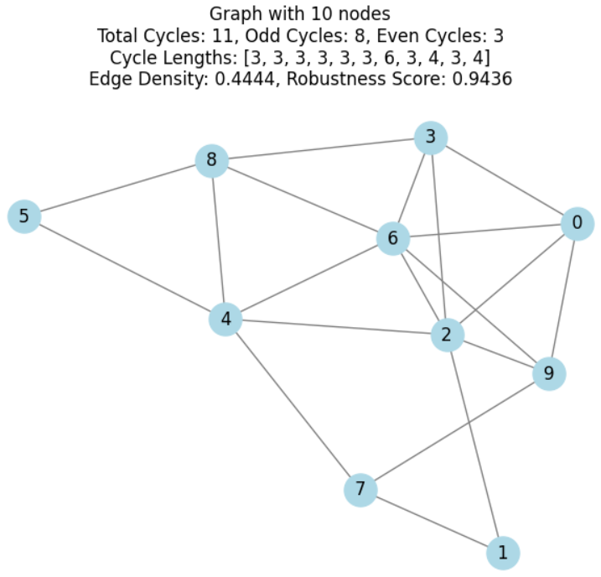
1. Introduction
Problem: This project focuses on solving the problem of generating graph structures that satisfy the odd cycle condition. The odd cycle condition ensures that within any connected component of a graph, any two odd cycles without common vertices are linked by at least one edge. This condition is important in various fields like graph theory, combinatorial optimization, and network analysis. Existing algorithms often face difficulties in creating graphs that meet these specific constraints, especially when the number of vertices becomes large.
Objective: The objective of this project is to develop a reinforcement learning-based algorithm that generates graphs satisfying the odd cycle condition. The focus is on optimizing the graph creation process by iteratively refining the structure through reinforcement learning techniques

Slide 4

2. Motivation & Background
Motivation : The motivation behind this project stems from the need to efficiently generate complex graph structures that satisfy specific conditions, like the odd cycle condition, which is crucial in areas like network design, optimization, and graph theory. Traditional algorithms struggle with this task, especially when handling large graphs with intricate requirements. By applying reinforcement learning, the project aims to explore how machine learning techniques can be leveraged to address these challenges, leading to more adaptable and scalable graph generation solutions.
Background : Graphs play a fundamental role in various domains such as network analysis, computer science, and biology, where relationships between objects are modeled as nodes and edges. The odd cycle condition is a key concept in graph theory, ensuring that certain structural properties are maintained. Existing approaches to graph generation often fall short when tasked with complex conditions like this. Reinforcement learning, with its capacity to optimize decision-making through trial and error, presents a promising approach to solving combinatorial problems in graph generation, which this project seeks to explore.

Slide 5
3. Project Structure
The project is divided into three key sections:
Markov Decision Process (MDP): Explains how the problem is modeled, with graph structures as states, edge manipulations as actions, and rewards guiding valid graph generation.
Proximal Policy Optimization (PPO): Describes the algorithm used to optimize the agent's policy in generating graphs while maintaining stability and efficiency.
Implementation: Details how the solution is implemented using a custom environment to simulate the graph generation process. We will discuss each of these sections in brief in the upcoming presentation.

Slide 6
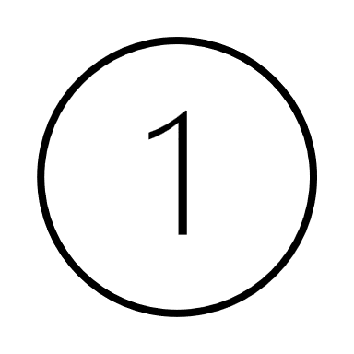
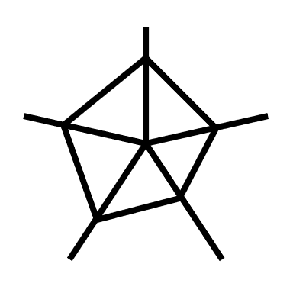

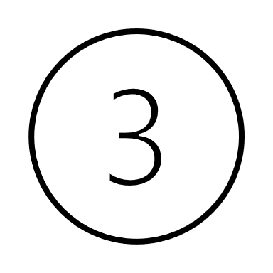

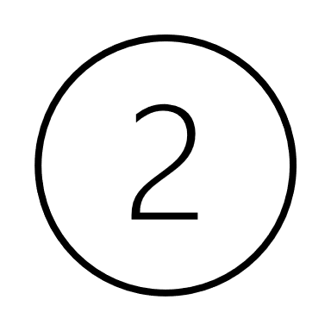
4. Markov Decision Process (MDP)
In this project, the task of generating graphs that satisfy the odd cycle condition is modeled as an MDP problem. It is a mathematical framework used for decision-making problems where outcomes are partly random and partly controlled by a agent. The graph structure is treated as a state, and the reinforcement learning agent interacts with this environment by taking actions (like adding or removing edges) to construct graphs. The agent transitions from one graph state to another based on the action taken, and receives rewards when the graph meets the odd cycle condition. This iterative process allows the agent to learn which actions lead to valid graphs while avoiding invalid structures.
An MDP consists of:
State: The current structure of the graph (nodes, edges, cycles).
Action: Adding, removing, or modifying edges to construct a graph that satisfies the odd cycle condition.
Transition: Moving from one graph structure to another after taking an action.
Reward: A positive reward when the graph adheres to the odd cycle condition, and penalties for creating invalid structures. This drives the learning process of the reinforcement learning agent.

Slide 7
5. Implementation.
The implementation relies on Gymnasium for simulating the reinforcement learning environment where the agent interacts with different graph structures, and NetworkX for generating and processing those graphs. A critical component of the implementation is the custom environment created using Gymnasium in a class.
This class models the graph generation task and includes:
State Representation: The current state of the graph is represented using an adjacency matrix or a list of edges and nodes.
Action Space: The possible actions include adding, removing, or modifying edges between vertices.
Reward Function: Positive rewards are given when the graph meets the odd cycle condition, and penalties are applied when the graph violates this condition.
Reset and Step Functions: These functions define how the environment resets to its initial state and how it transitions after each action is taken by the agent.
This environment is where the PPO agent learns through interaction, gradually improving its ability to generate graphs that meet the specified condition.

Slide 8
6. Proximal Policy Optimization (PPO)
The Proximal Policy Optimization (PPO) algorithm is used in this project due to its balance between efficiency and stability in training reinforcement learning agents. PPO is well-suited for problems like this where the state and action spaces are large and complex, such as manipulating graph structures. PPO works by optimizing the policy while preventing overly large updates through a clipping mechanism, ensuring stable learning without drastic changes in the policy. This is crucial when the goal is to generate graphs that meet the odd cycle condition, as it prevents the agent from making extreme, suboptimal decisions during training.
PPO optimizes the policy by:
Clipping the objective function to limit drastic policy updates.
Balancing exploration (trying new actions) and exploitation (optimizing known good actions).
Gradually refining the agent's decision-making to generate valid graph structures while satisfying the odd cycle condition.

Slide 9
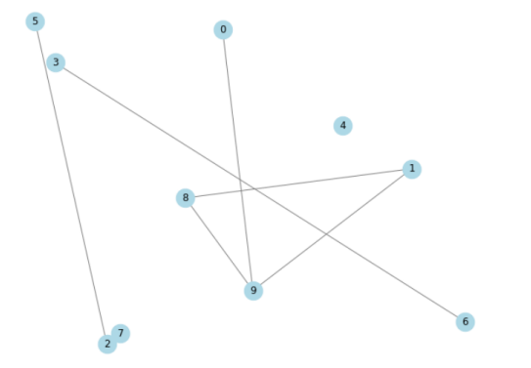
7. Experimental Research.
This is the first graph generated in this project. While it successfully satisfies the odd cycle condition, it contains isolated vertices. Isolated vertices, such as vertices 4 and 7 in this graph, are nodes that are not connected to any other node within the graph. These isolated vertices do not form part of any cycle, and their presence may limit the overall connectivity of the graph. Although the odd cycle condition is met, the presence of these isolated nodes suggests that further refinement is necessary to ensure full connectivity, which is important for certain graph applications. In subsequent iterations, adjustments were made to address these isolated vertices while maintaining the odd cycle condition.
Figure 1 : Graph with isolated vertices.

Slide 10
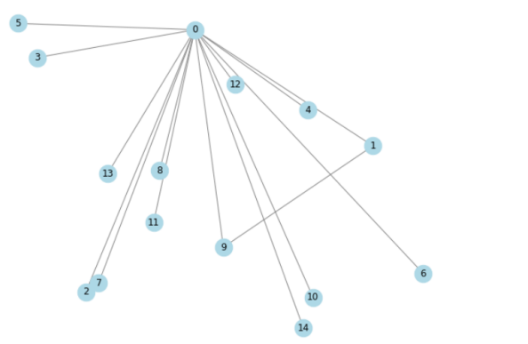
7. Experimental Research.
In the next iteration, the minimum spanning tree algorithm was applied to connect all the vertices. However, this resulted in a tree-like structure with vertex 0 as the root node. The issue with this configuration is that if node 0 is removed, all other vertices become isolated, indicating a lack of robustness in the graph due to its reliance on the root node. Therefore, further modifications were necessary to create a more resilient structure, which were implemented in subsequent steps.
Figure 2 : Graph with MST Algorithm.

Slide 11
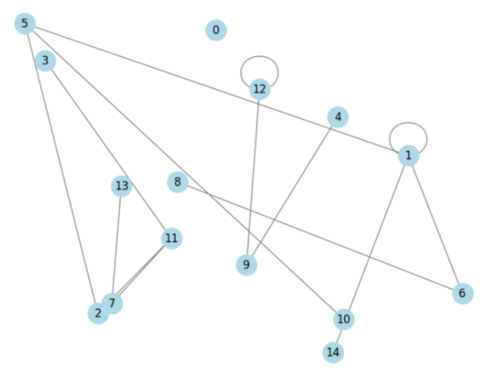
7. Experimental Research.
In the third iteration, the graph included self-loops at vertices 1 and 12, which are undesirable in this context. Additionally, vertices 12, 4, and 9 formed a separate subgraph, reducing overall connectivity. To address these issues, a condition was added to penalize the reward if a self-loop is formed, encouraging the model to avoid them. Changes were also implemented to ensure that vertices within the graph remain connected, improving the overall structure in subsequent iterations.
Figure 3 : Graph with self loop.

Slide 12
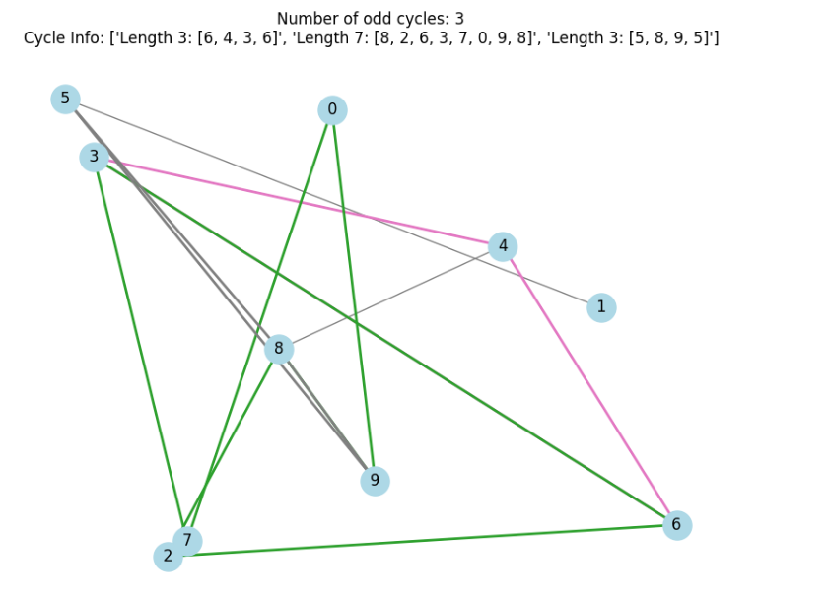
7. Experimental Research.
In the final iteration, the graph still included self-loop vertices, which were causing issues as the model considered them as odd cycles with a single vertex. To address this, self-loop vertices were excluded from the odd cycle count. Additionally, each odd cycle in the graph was assigned a distinct color for better visualization, and the length of each cycle was displayed as part of the output. This final improvement allowed for a clearer understanding of the odd cycle structure within the graph.
Figure 4 : Odd cycle graph.

Slide 13
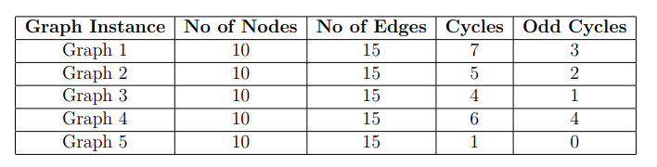
8. Evaluation Metrics
RESULTS
To assess the effectiveness of our reinforcement learning model in generating graphs that satisfy the odd cycle condition, we evaluated several key metrics. These metrics measure both the structural properties of the generated graphs and their adherence to the odd cycle condition.
Cycle Parity Check:
This metric confirms that the generated graphs follow the odd cycle condition by detecting and counting cycles in the graph. We used Depth-First Search (DFS) algorithms to detect cycles and determine whether they are odd or even. The table below shows the number of odd cycles detected in various graph instances.
Table 1: Cycle Parity Check Results

Slide 14
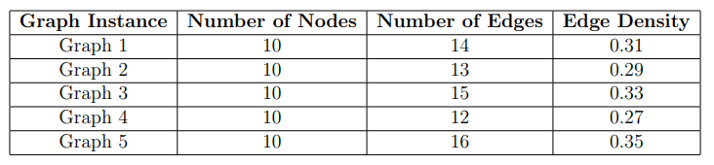
8. Evaluation Metrics
RESULTS
Edge Density:
Edge density measures the overall connectivity of the graph by comparing the number of edges to the maximum possible edges. It ensures a balance between sparse and dense structures, which is crucial for both performance and maintaining the graph's structural soundness. Higher edge density indicates better connectivity, while lower density may suggest under-connectivity. This is evaluated through
Measures graph connectivity by comparing the number of edges to the maximum possible edges.
Ensures balance between sparse and dense graph structures for optimal performance.
Formula: D = 2E / N(N - 1)​ , where E is the number of edges and N is the number of nodes.
Table 2 : Edge density

Slide 15
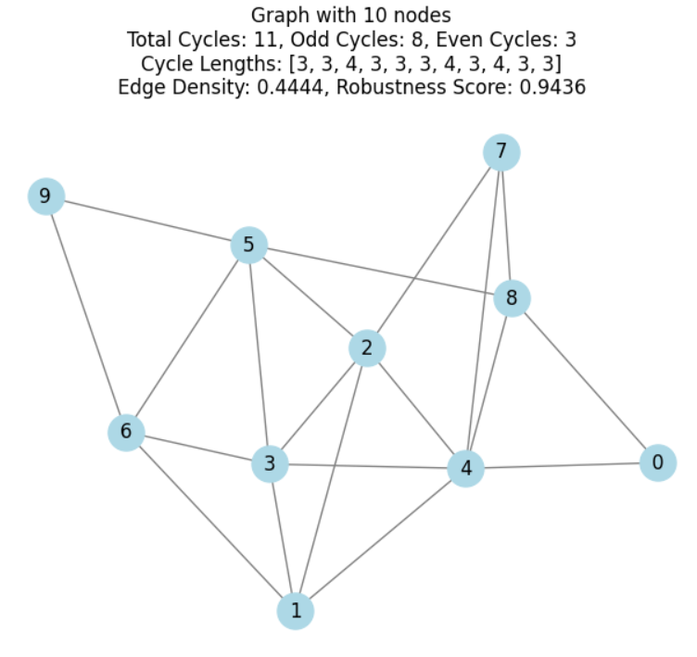
8. Evaluation Metrics
RESULTS
The final output is represented as a graph with 10 nodes, showing the connections and cycle structure generated by the model. The graph contains a total of 11 cycles, with 8 odd cycles and 3 even cycles, successfully meeting the odd cycle condition. The lengths of these cycles are also displayed, with odd cycles having lengths of 3 and 4. Evaluation metrics such as Edge Density (0.4444) indicate a balanced connectivity. Overall, the graph meets the desired conditions and reflects strong connectivity.
Figure 6 : Final output

Slide 16
9. Conclusion
This project successfully developed a reinforcement learning-based approach to generate graphs that meet the odd cycle condition. Throughout the process, challenges such as isolated vertices, self-loops, and connectivity issues were identified and addressed. Techniques like penalizing rewards for undesirable graph structures and visualizing odd cycles were implemented to improve the model's performance and ensure more robust graph configurations.
Moving forward, improvements should focus on enhancing both the scalability and stability of the model. At times, the model produced graphs that deviated from the specified conditions, creating completely different structures. Addressing these stability issues will help ensure consistent adherence to the required graph properties. Further optimization of scalability will also allow the model to handle larger graphs more efficiently, contributing to more reliable applications in future graph-based analysis and research.

Slide 17
Thanks!
Any questions?

